Slide 1
SSW-810: Software Engineering Tools and Techniques
Relational Database Technologies and Techniques
Prof. Jim Rowland
Software Engineering
School of Systems and Enterprises

Slide 2
Acknowledgements
This lecture includes material from:
http://www.tutorialspoint.com/dbms/
https://www.tutorialspoint.com/sqlite/sqlite_python.htm

Slide 3

Today’s topics
Database overview
Common database solutions
Have you seen my keys?
Queries
Select
Update
Delete
Defining tables
Interacting with databases from Python

Slide 4
Database Overview
Databases contain a collection of related information, organized to allow efficient access and retrieval
Several different database solutions:
Relational Database Management System (RDBMS) – data is structured in predefined tables by row and column
Object Oriented Databases – all data is represented and stored by objects
NoSQL - unstructured data is stored and processed in potentially massively parallel solutions
Source: http://www.dictionary.com/browse/object

Slide 5

Many Database Solutions

Slide 6
Why use a RDBMS?
Why not just store data in a flat file?
(Flat files may be the best solution for some problems)
Databases support:
Transaction processing/Atomicity
Multiple concurrent simultaneous users
A common query language across vendors
Data consistency enforcement
Access control

Slide 7
ACID properties
A transaction must have ACID properties
Atomic - all steps complete successfully or no change
Consistent – both successful and unsuccessful transactions must leave the system in a consistent state
Isolated – the data involved in the transaction must be isolated from other users until the transaction is complete
Durable – the changes must survive permanently

Slide 8
Transaction Atomicity
Consider a banking application where a customer transfers money from one account to another
Transfer requires two steps:
Deduct funds from first account
Deposit funds to second account
What if something goes wrong in either step?
Need to insure that both steps are successful or the account can be left in inconsistent state
Complete both steps successfully or rollback all changes

Slide 9
Relational DBMS Characteristics
Data represents real world entities
Data stored in relational tables
Tables are analogous to spreadsheets with rows and columns
Tables may be related by “keys” which can be used to join multiple tables to find related information
Tables are designed to minimize redundant information
Use query languages (SQL) to retrieve information
Support transactions for consistency
Support multiple concurrent users

Slide 10
Example Domain
Create a database solution
Start up company has employees and projects
Track who’s working on which projects

Slide 11
Entity Relationship Model
Entities represent some physical or logical object
E.g. employee, manager, project …
Entities may have properties or attributes
An employee has an ID number and a title
A project may have a set of employees
Keys are attributes that uniquely identify one instance of an entity from other instances
e.g. an employee ID uniquely identifies each employee

Slide 12
Entity Relationship Models
Emp_ID
Name
Project
Emp_ID
Employee
Member
many
many
Project
Title
Salary
Employees Table
Projects Table
Emp_ID | Name | Title | Salary
123 | Nanda | Developer | 80000
234 | Sujit | Tester | 70000
345 | Jim | Manager | 85000
Project | Emp_ID
OnlineBanking | 123
GameConsole | 234
OnlineBanking | 234

Slide 13
Representing Entities in a Relational DB
Entities are typically represented in tables
Attributes are represented as columns in the table
Instances are represented as tuples (rows) in the table
Tables may include a primary key to uniquely identify the instance of the entity represented by the tuple/row
Employees Table
Projects Table
Emp_ID (Key) | Name | Title | Salary
123 | Nanda | Developer | 80000
234 | Sujit | Tester | 70000
345 | Jim | Manager | 85000
Project | Emp_ID
OnlineBanking | 123
GameConsole | 234
OnlineBanking | 234

Slide 14


Database Tools
Many different tools to work with databases
Create and explore tables
Write and run queries

Slide 15
SQLite is a small, open source, file based RDBMS
Download from https://sqlite.org/download.html
Works with files or in memory databases
Create a new database
$ cd 810/assignments
$ sqlite3
Connected to a transient in-memory database.
sqlite> .save 810_startup.db
sqlite> .exit
SQLite supports in-memory and on disk databases
Create a SQLite database file in 810_startup.db

Slide 16
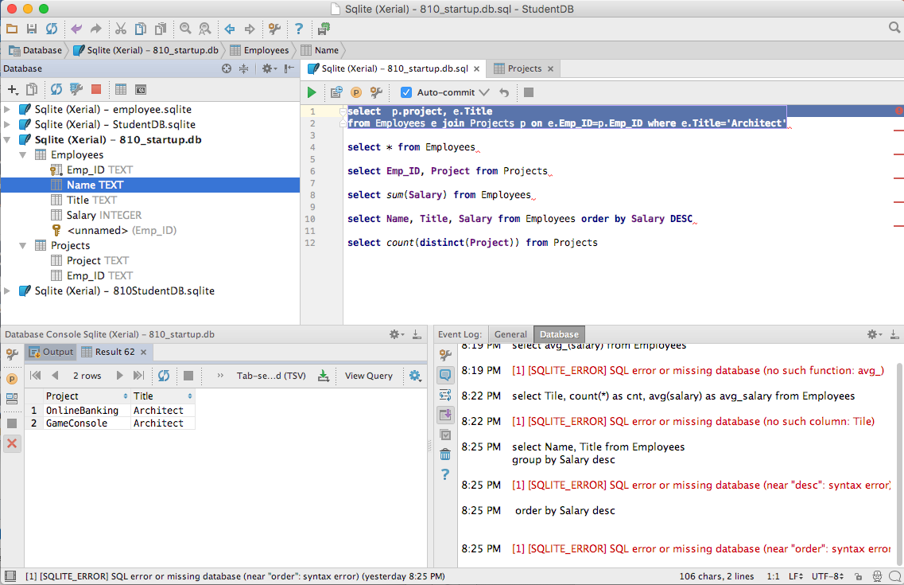
JetBrains DataGrip
Explore table definitions
Write and execute queries
General information
See query outputs

Slide 17
DataGrip Features
Connect to many different relational databases
SQLite, Oracle, MySql, PostgreSQL…
GUI automates many common tasks
Table definition
Create data table from file
Save query output to a text file
Auto completion for table names and attributes
Free download for academic use
Part of the JetBrains product line, including PyCharm

Slide 18
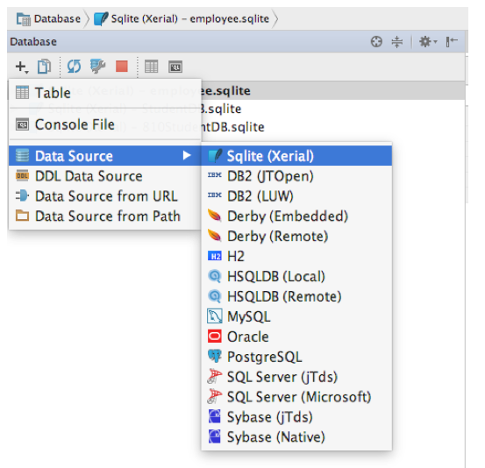
DataGrip: Open the database
DataGrip supports many databases.
We want to open our Sqlite DB
Let’s open our new 810_startup.db

Slide 19
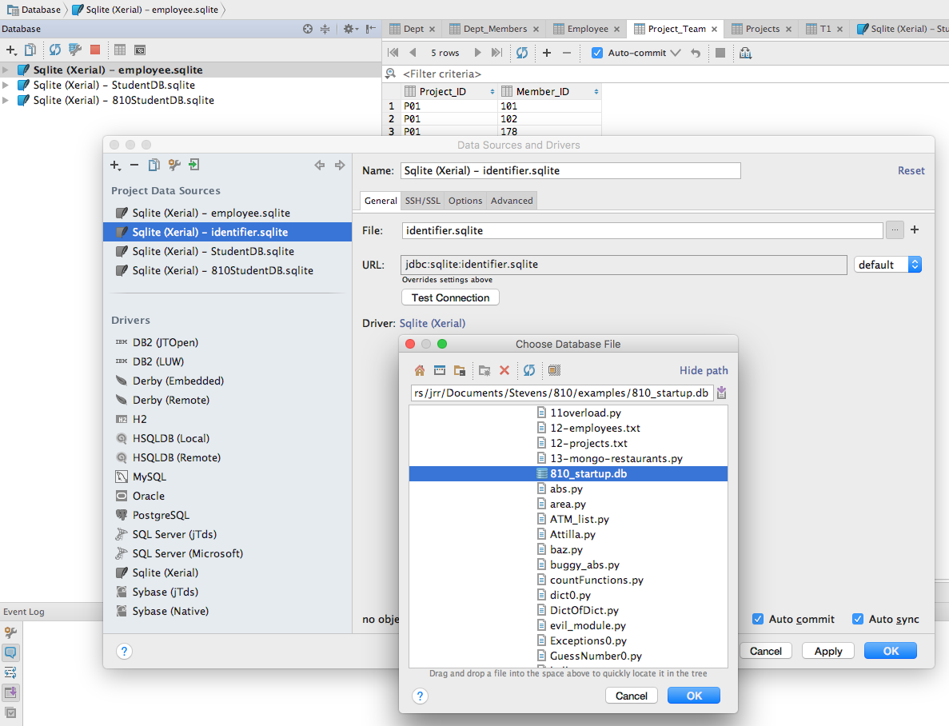
DataGrip: Open the database
Open a file browser
Choose the .db file we created

Slide 20
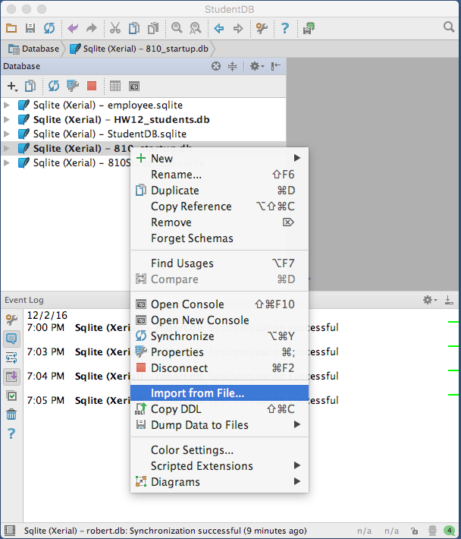
DataGrip: Import a file into a table
Right click on your database file
Choose “Import from File…”

Slide 21
Database operations
Command | Semantics
Create | Create a database, table, or view
Drop | Drop a database, table, or view
Alter | Modify the database schema
Insert | Insert new records into the table
Update | Update one or more attributes in an existing record
Delete | Delete one or more rows from a table
Select | Select a subset of records from the table based on selection criteria

Slide 22
Create a new table
Specify:
The table name
Each attribute in the table
The data type of each attribute in the table:
INTEGER, REAL, TEXT, BLOB
Optional constraints on attributes
NOT NULL
PRIMARY KEY
FOREIGN KEY
DBMS may support different types

Slide 23
Create Table SQL Examples
CREATE TABLE Employee(
Emp_ID TEXT PRIMARY KEY NOT NULL,
Name TEXT,
Title TEXT,
Salary REAL
)
CREATE TABLE Project (
Project TEXT PRIMARY KEY NOT NULL,
Emp_ID TEXT
)
Primary Keys uniquely identify an entity
NOT NULL adds a constraint to the value

Slide 24
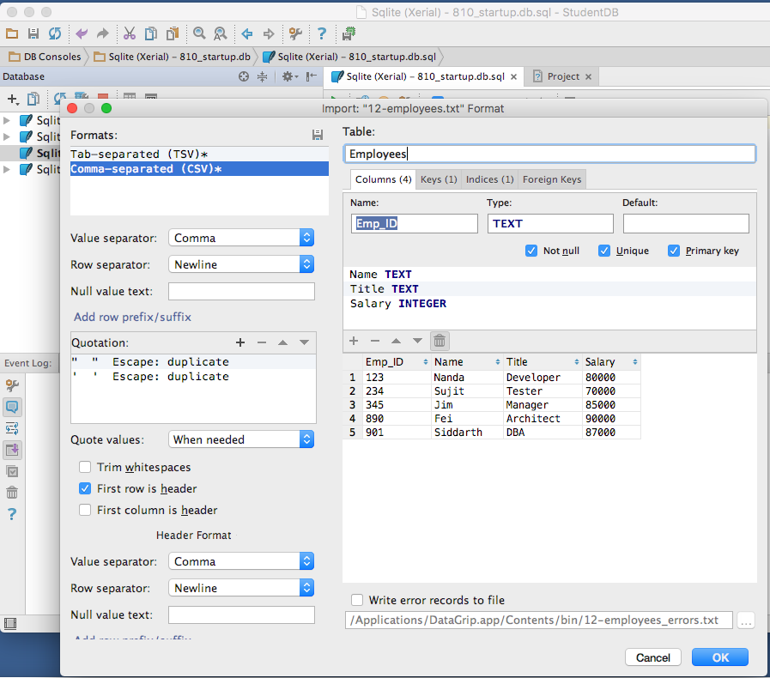
Create a new table from a data file
Choose a name for the new table
DataGrip only allows comma, semicolon or tab separators
Adjust name and type
The data to import
Optionally read column names from the file

Slide 25
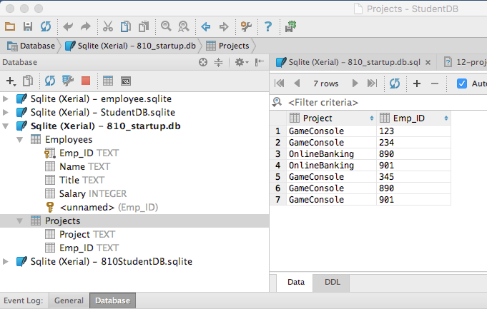
Repeat for Projects Table
Employees Table
Projects Table
Projects data

Slide 26
Insert records
Insert a single row
INSERT into <TableName> [(column_name, …) ]
VALUES (<value1>, <value2>, …);
INSERT into Employees (Emp_ID, Name, Title)
VALUES (123, ‘Nanda’, ‘Developer’)
Insert rows from a select query
INSERT into <TableName> (<ColumnNames)
SELECT <Columns> from <Table1>

Slide 27
Alter Table
Change the name of a table
Change the features of a table
Add/drop attributes
Change data type of an attribute

Slide 28
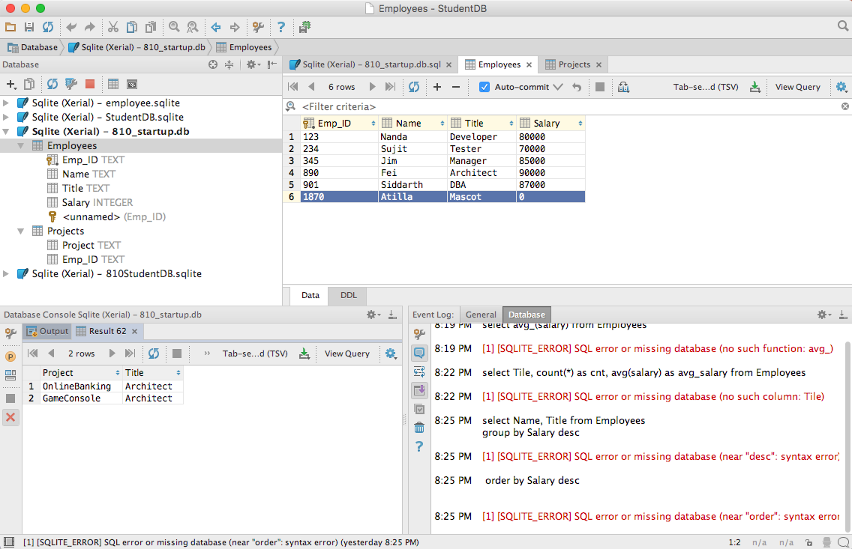
Delete rows from a table
delete from <table> where <condition>
delete from Employee where Title=‘Mascot’
All rows matching the criteria will be deleted
Choose a row and hit CMD/CTRL <delete>

Slide 29
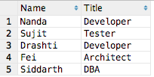
Select queries
Select chooses a set of rows and columns from one or more tables
SELECT column₁, …, column_{n} FROM table
select Name, Title from Employees
Select returns a result table

Slide 30
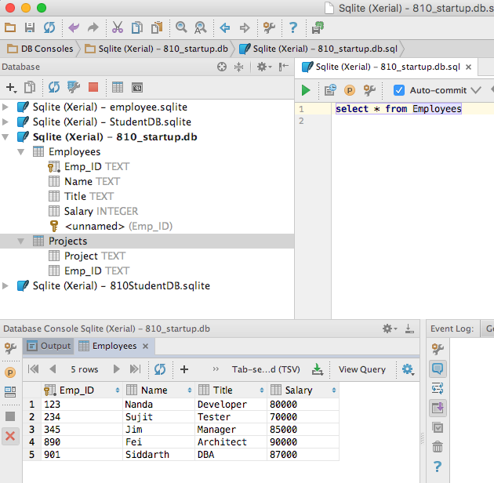
Select with DataGrip
If you don’t see a ”green button”
Right click on your database name and select “open console”
Query results appear here

Slide 31
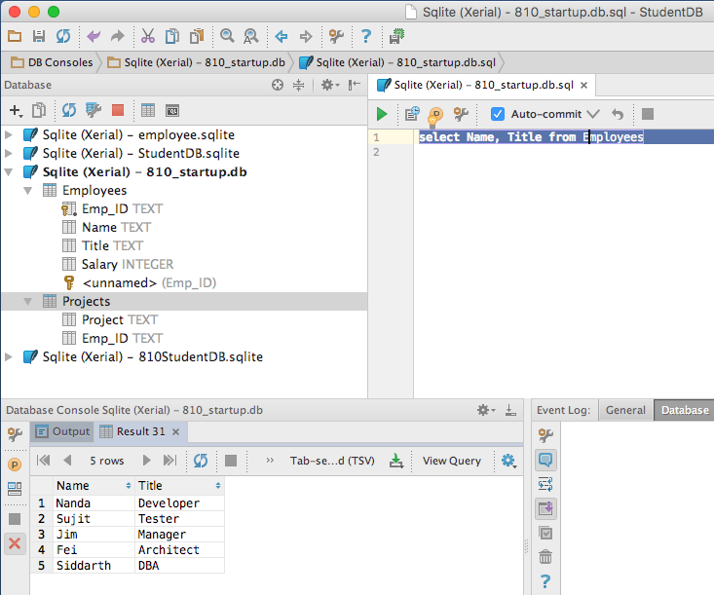
Select with DataGrip
Write the query, then click the “go” icon
Highlight your select statement
Results appear here

Slide 32
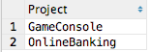
Special SELECT alternatives
SELECT * from <Table>
Select all rows from <Table>
SELECT COUNT(*) FROM <Table>
Select the number of rows in <Table>
SELECT DISTINCT column₁ FROM <Table>
Select all distinct values of column₁ from <Table>
SELECT DISTINCT(Project) FROM Projects

Slide 33
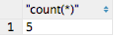
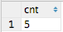
Select Aliases
Change the label in the results of a SELECT query
SELECT COUNT(*) FROM Employees
SELECT COUNT(*) AS cnt FROM Employees

Slide 34
Aggregate functions
Useful aggregate functions for SELECT
Aggregate Function | Returns
AVG(<COLUMN>) | Average of the specified column
COUNT(<COLUMN>) | Number of non-NULL values in the column
COUNT(*) | Number of rows in the table
MAX(<COLUMN>) | Maximum value the specified column
MIN(<COLUMN>) | Minimum value in the specified column
SUM(<COLUMN>) | Sum of the specified column

Slide 35
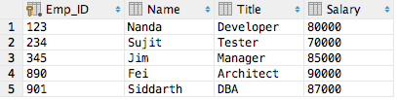
Aggregate functions
Employees Table
Query | Result
select avg(salary) from Employees | 82400
select count(Title) from Employees | 5
select count(*) from Employees | 5
select max(Title) from Employees | Tester
select min(Name) from Employees | Fei
select sum(Salary) from Employees | 412000

Slide 36
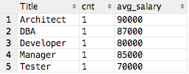
Aggregate functions and GROUP BY
SELECT <COLUMNS> GROUP BY <COLUMNS>
Groups the common values together
select Title, count(*) as cnt, avg(Salary) as avg_salary from Employees group by Title
Group the rows by Title when computing aggregates

Slide 37
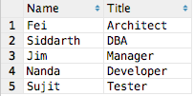
Select ORDER BY
SELECT <COLUMNS> ORDER BY <COLUMNS> [ASC | DESC]
Orders the output table by the specified columns
select Name, Title from Employees order by Salary DESC
Order the rows in descending order by salary

Slide 38
Select Where
Select a set of rows and columns from one or more tables that meet the specified criteria
SELECT column₁, …, column_{n}
FROM table
WHERE column <operator> <value>
Operators include =, !=, <>, >, <, >=, <=, !<, !>
select name, Title from Employees
where name = ‘Jim’
select * from Employees
where salary >= 70000
Select returns a result table

Slide 39
Data Normalization
Database tables are designed for efficiency
Eliminate redundant data – store it once
Save space
Make changes easier because the data is stored only once
Project Example
Employee: Name, Title, Salary
Project: Project, Employees assigned to that project

Slide 40
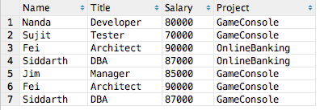
Option 1 – (not a great solution)
Represent all data in a single table (“Excel Solution”)
What happens if Fei is promoted from Architect to Chief Architect and gets a raise?
Must find and update all relevant rows or the data will be inconsistent
Must find and update all relevant records consistently

Slide 41
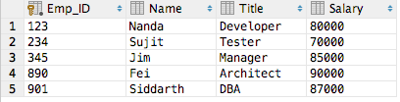
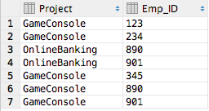
Option 2 - Store each item once
Employees
Projects
Any change in Employees or Projects requires only one change
But how to see the tables together???

Slide 42

Joins
Data is frequently stored in multiple tables
Use keys to join multiple related tables
Primary Key
One or more columns
Uniquely identifies a row in a table
Foreign Key
Refers to a Primary Key in a different table
Used to join tables
Not all tables have keys but we can join on any field

Slide 43
Option 2 - Store each item once
Employees
Projects
Any change in Employees or Projects requires only one change
But how to combine the data across tables???

Slide 44
Join
Joining tables on primary/foreign keys allows us to combine fields from relevant tables
SELECT <columns>
FROM
<TABLE1> <ALIAS1>
JOIN <TABLE2> <ALIAS2>
ON <ALIAS1>.<COLUMN> = <ALIAS2>.<COLUMN>
Join returns a result table with all of the rows meeting the constraints

Slide 45
Option 2 - Store each item once
Employees
Primary Key
Projects
Foreign Key
Primary/Foreign Keys relate records from different tables

Slide 46
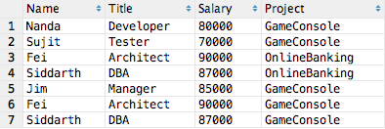
Option 2 - Store each item once
Employees
Projects
select e.Name, e.Title, e.Salary, p.Project from Employees e
join Projects p on e.Emp_ID=p.Emp_ID
Employees joined with Projects

Slide 47
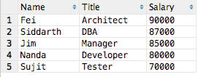
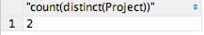
Answering questions with queries
Who is the highest paid employee?
select Name, Title, Salary
from Employees order by Salary DESC
How many projects?
select count(distinct(Project)) from Projects

Slide 48
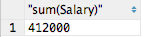
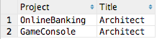
Answering questions with queries
What is the total salary for all employees?
select sum(Salary) from Employees
Which projects have an Architect?
select p.Project, e.Title from Employees e
join Projects p on e.Emp_ID=p.Emp_ID
where e.Title='Architect'

Slide 49
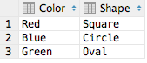
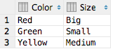
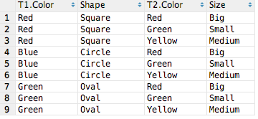
Other types of queries: Join
T1
T2
select * from T1 join T2 (No qualifications)
→ Full cross product of all combinations
T1
T2

Slide 50
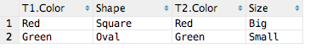
Other types of queries: Join on
T1
T2
select * from T1 join T2 on T1.Color = T2.Color
(aka inner join)
→ Only rows from T1 and T2 where T1.Color = T2.Color
T1
T2

Slide 51
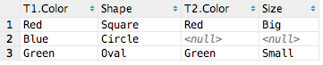
Other types of queries: Left Join
T1
T2
select * from T1 left join T2 on T1.Color = T2.Color
All rows from T1 and matching rows from T2 where T1.Color = T2. Color
T1
T2

Slide 52
Accessing Databases with Python
Python provides APIs to interact with databases
Approaches:
Database specific APIs using module for each database
SQLAlchemy
Add a logical layer between Python code and the database
Object Relational Manager (ORM)
Python
SQLAlchemy
Object Relational Manager (ORM)

Slide 53
Python Database APIs
Action | Semantics
Connect | Open a connection to the database
Create | Create tables, insert rows
Read | Select rows
Update | Update existing table rows
Delete | Delete existing table rows
Commit | Commit transaction changes
Roll back | Undo changes since last commit
Close | Close the database connection

Slide 54
Database Operations and Python APIs
Commit
Connect to Database
Execute Queries
Close Database
Rollback

Slide 55
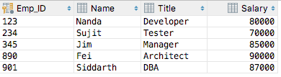
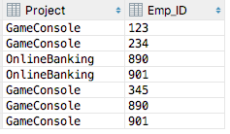
Start-up company sample database
Employees Table
Projects Table

Slide 56
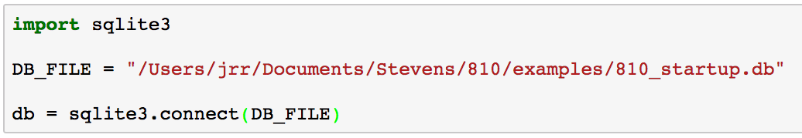
Connect
SQLite supports both memory and file-based databases
connect(path) opens the database at path or in memory if path == ‘:memory:’
Beware: SQLite creates a new database file if you specify a non-existent file

Slide 57
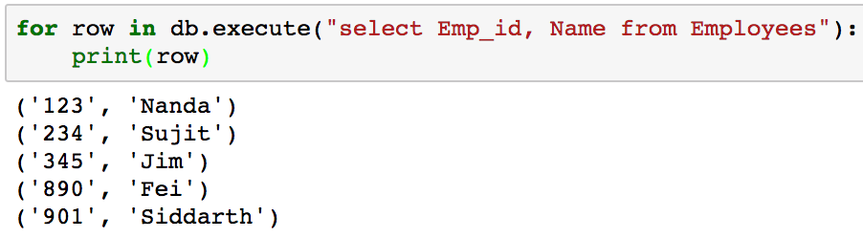
Select queries
Execute arbitrary queries
Execute(query)returns a sequence of tuples with the rows from the query

Slide 58
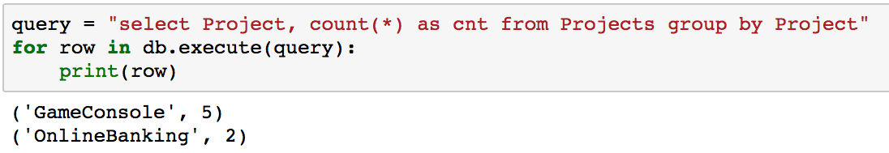
Select queries
Execute any valid query, including aggregations

Slide 59
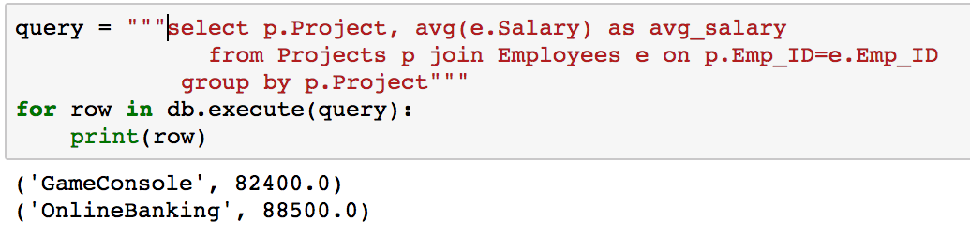
Select queries
Execute any valid query, including joins, group by, etc.
Write and test queries in DataGrip then copy SQL

Slide 60
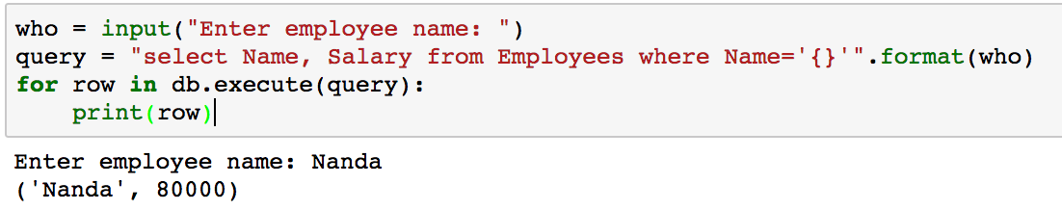
Parameterized queries
How to add a parameter to a query?
The query is just a string, so create a string to represent the query
What could possibly go wrong?
Simple, but wrong…

Slide 61
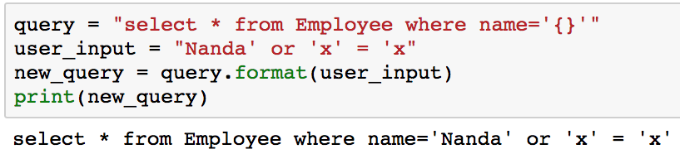
SQL Injection Attacks
Scenario:
A bad actor is authorized to see only his own salary but wants to know all salaries
A naïve developer concatenates user input as part of the query
The bad actor injects extra SQL in the input to change the query
Matches ALL rows

Slide 62
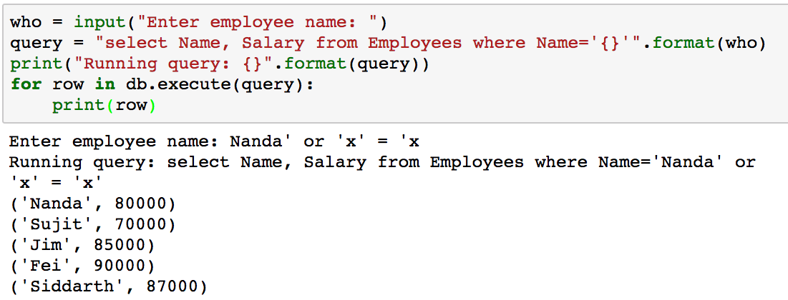
SQL Injection Attack on Parameterized Query
Looks okay, right???
Bad actor changed the query from input
blah
WAIT!!!
That’s not what we intended!

Slide 63
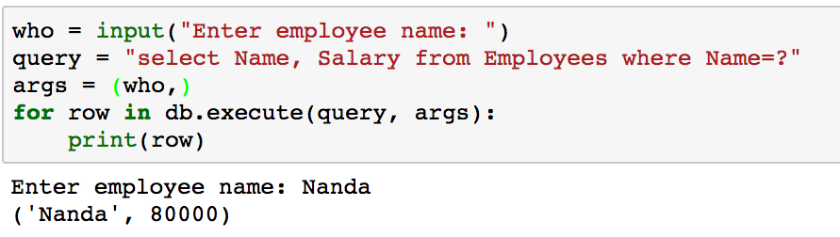
Preventing SQL Injection Attack on Parameterized Query
Include ‘?’ in the query for each parameter and pass the parameters separately as a tuple
execute checks the parameters to prevent SQL Injection attacks
Specify ‘?’ in the query for each parameter
Pass the arguments to execute() as a tuple

Slide 64
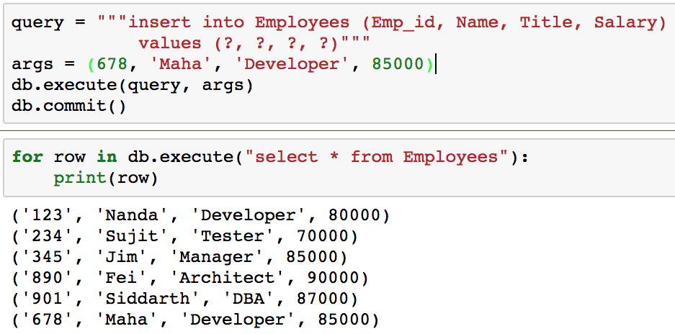
Insert queries
Insert rows into tables using computed values
The new row won’t appear in queries until commit()
The new row

Slide 65
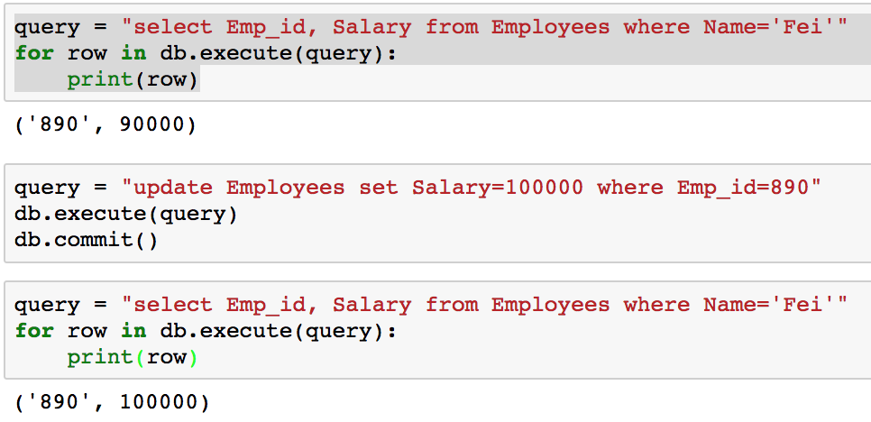
Update queries
Fei earned a raise
The new row won’t appear in queries until commit()
The updated row

Slide 66
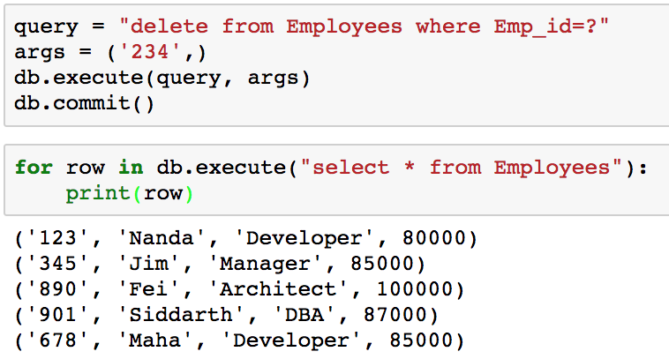
Delete queries
Emp_ID 234 has been deleted

Slide 67
Close
Use close() to close the connection to the database

Slide 68
SQLite Python API Summary
Action | Semantics
Connect | Open a connection to the database
Create | Create tables, insert rows
Read | Select rows
Update | Update existing table rows
Delete | Delete existing table rows
Commit | Commit transaction changes
Roll back | Undo changes since last commit
Close | Close the database connection

Slide 69

Questions?

